Slide 1
Technology in schools
Why do girls get turned off?
Eileen Brown
Manager, IT Pro Evangelist Team,
Developer & Platform Group
Microsoft UK
http://blogs.technet.com/eileen_brown

Slide 2

If we truly believe children are our future, now is the time to ensure that they have a place in the future we have created.
Valerie Giles www.cyber-prof.com

Slide 3

What does this number mean to Microsoft?
13,000
Job Openings at Microsoft

Slide 4

Why So Many Openings?
Not enough qualified people in the world to meet the demand for IT workers

Slide 5
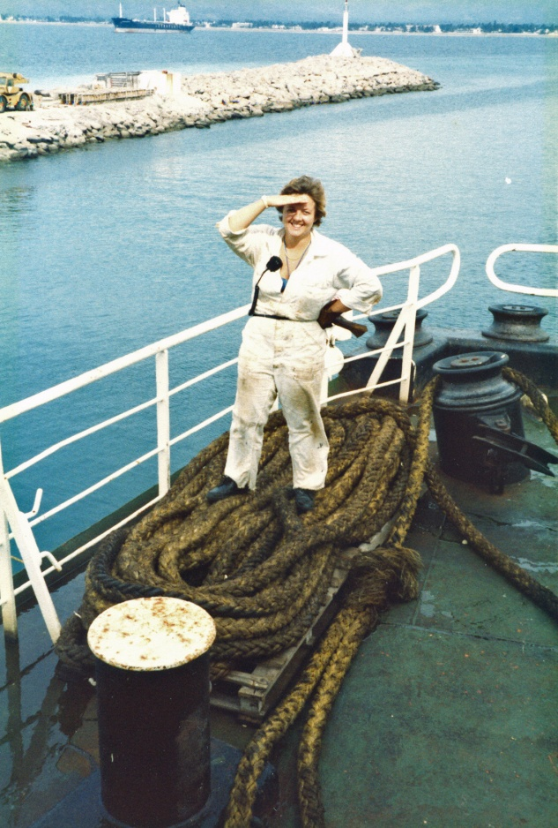
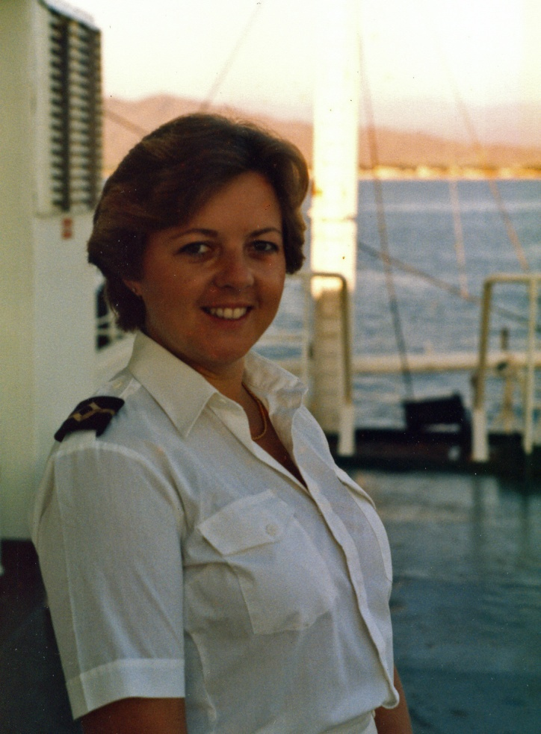


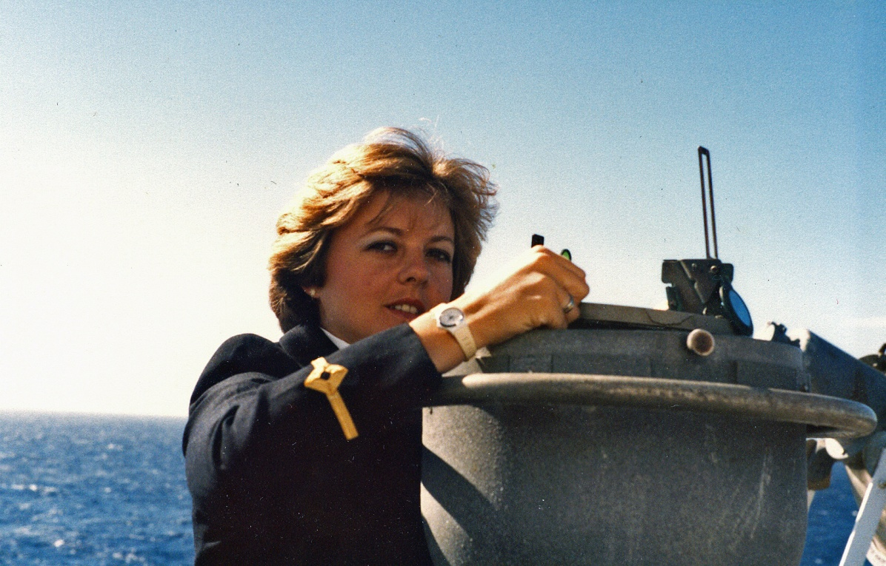


Different beginnings...

Slide 6


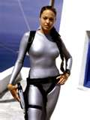





Girls play Games
“Hardcore” games, "casual" games, strategy games, adventure games, fighting games, mind games, games games games all the time every day.

Slide 7

Barriers in the early years
From 5
  Definite views about what men and women should do
From 11
  Concerns about careers in science
    Teachers need to be more aware "of the extent and pervasiveness of gender stereotyping" among young children
    Girls should be helped and encouraged to fully involve themselves in the science and technology curricula.

Slide 8

Evolution of PC Video Games
Early Years
Rock/Paper/Scissors – the core fundamental mathematic in every game
Adventure Games – (1983-1987 ) text based story puzzle adventures that were played from a DOS prompt ie:
C:/adventure
There is a white house
C:/adventure type open door
Door is locked.
C:/adventure type examine window
Window is slightly ajar.
C:/adventure type enter window
You are in the white house
Notes:
RPG= Role Playing Games most RPG’s have a number of characters to choose from all with different attributes

Slide 9
Evolution of PC Video Games
Early Years
Graphic Shooters (1986-1992) because that’s all there was (Doom, Duke Nukem, Quake
  Finally girls are able to save the world and kick ass too
  Male characters in first person (visually a male hand holding the guns, grenades, or fist)
Video Gaming Consoles: (1987-1995)
  Sega Genesis Sonic the Hedgehog, Nintendo 16bit Mario Brothers, Zelda – The Adventures of Link (a boy saving a princess)
Lara Croft: Tomb Raider (1994 ? ) – first girl shooter game/adventure game
  Targeted for men who needed a cyber girlfriend.
  Not made by girls because no girl looks like that until Angelina Jolie 10 years later
Notes:
RPG= Role Playing Games most RPG’s have a number of characters to choose from all with different attributes

Slide 10
Evolution of PC Video Games –
PC vs. Console
PC’s
  O/S dependency
    PC Memory, Chipsets, motherboard and graphics card to create a better experience
  Solitaire
    Used universally to train new PC users on how to use a mouse. Online gaming is born (largest demographic >40 women)
Video Game consoles
  Hardware advantage
    Custom boards, proprietary chip and graphic card design render a better experience.

Slide 11
Evolution of PC Video Games
Game Play
Finally, the story becomes important.
Story + Cool Features = Game Play
  Games that have lasting iconic staying power are those that draw the end user into the story.
Fan Loyalty = More Games Sold = more Revenue
Examples:
  Myst – URU (you are you) exquisite graphics, mythical world, evolving story line, ability to control story outcome
  Usable avatar generator to create every physical resemblance of the actual player
  Halo (I,II & III)- best selling video game of all-time. Four novels and potentially major motion picture

Slide 12
The problem with the Gaming industry
Options
  not dependant upon personal effort at school and subsequent education/ career choices.
Dependant on other factors
Confidence and motivation
  Push for a career in an industry that to all intents and purposes doesn’t even exist in their world?

Slide 13

Technology Trends
MYTH: Computing Science
careers are just for men.
FACT: Everyone has a voice in shaping technology trends.
1. Technology is pervasive in society, its impact is only going to increase.
2. Women took on slightly more than half of U.S. jobs created in the first part of the decade and made gains in securing the most lucrative openings.
3. Increase in females faculty and postdoctoral students across the nation.
Resources:
1.] Wall Street Journal, Women Outpace Men In Number of New Jobs
2.] http://www.umbc.edu/cwit/news.html

Slide 14

“Other women are more likely to see me as 'geeky' because I work in technology”
“Yes they do, but I like being geeky and I don't care! Geeky is good! Don't
assume geeky is negative!”
“I'd rather be a geek than a shelf stacker.”
“I was always seen as geeky by any non-technical females and was often treated
as an outcast because of the department I worked in.”
“I run a dot-com start-up. Most of my peers see that as very cool—not geeky.”
“Other women are more in awe of what I do!”
Notes:
9/9/2008 2:33 PM
© 2005 Microsoft Corporation. All rights reserved.
This presentation is for informational purposes only. Microsoft makes no warranties, express or implied, in this summary.
14

Slide 15

Women in Games?
41% of Australian Gamers are Women
  Average age 28
30% US Women Gamers
  7.4 hours week
Successful games: Sims / World of Warcraft
  Both about building relationships
The key to creating more games that appeal to women is to get more women into the industry.
  By diversifying the workforce, developers hope to create products that appeal to a wider audience.

Slide 16
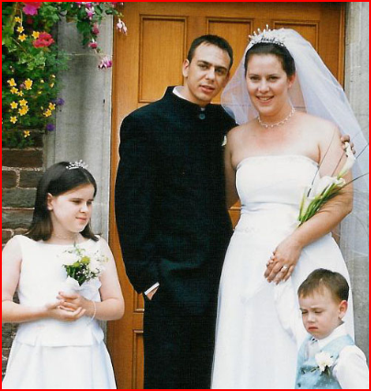
Lisa Bidder
Xbox MVP
Keep hitting that wall - eventually you will break it down

Slide 17

Anatomy of a Girl Gamer
Loves great game play – let me be “in the game” & give me realistic
    a story that reads like a book
    sweeping vistas
    epic adventure
    problem solving
    ability to kick some ass if necessary
    blood smears (contextual note: comes from a biology major background)
    physical movements

Slide 18
Anatomy of a Girl Gamer
Enable Fantasies
  Rock Band & Guitar Hero – living out dreams
    playing guitars & singing
    fashionista – can change avatar clothes to something I would never wear
  Card & Board Online Games – never have to endure family ridicule when losing
Connect with Guys
  EASPORTS – design cheerleading feature to co-play with guys playing football
  Visual Social Networks – keeping global relationships interactive

Slide 19


Slide 20


Situation
Women represent 46% of the UK workforce
18% of IT professionals
17% of the IT and Telecoms workforce.
  17% of students starting computer science degrees are women
  Majority are from overseas.
Radical action is needed to redress the gender imbalance.
Number of women employed in technology industries fell from 27% in 1997 to 21% in 2005
source: Office of National Statistics (ONS)

Slide 21
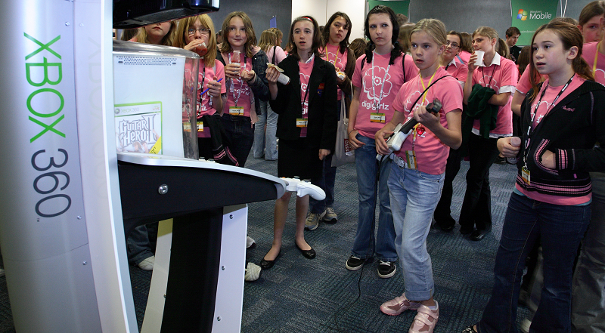
Goal
To help redress the gender imbalance in the IT industry by reaching out to girls between 12 to 15 years and encourage them to think differently about a career in IT. This includes IT services, marketing and sales.

Slide 22
Success?
“A number of girls on the bus are crying - they’ve enjoyed themselves so much…” (teacher Emmbrook school)
“Thank you for the great day out! It was very interesting and informative. I found the morning presentations a little drawn out and would have liked more time on the workshop as this felt very rushed. Thanks for everything.”
“I am writing this letter to thank you for inviting me to take part in the ‘DigiGirlz’ day. I found the day quite enjoyable. The mornings lectures were quite helpful as you helped us discover the other side of ICT, however I feel that they were quite long. The access to Microsoft products assisted our learning of different sources of ICT. The afternoon activities were interesting and creative and I think gave me an insight to what ICT can really do. The day was a new and inspirational experience as I came away from it motivated to use ICT and to pursue a career in it.
Thank you once again for the great day at Microsoft. “

Slide 23
Learnings
This audience is the online generation
  using everything from chat forums to Facebook
  disinterested in the technology that enables it to work
The majority of those attending the event stated that they found their ICT lessons dull and uninspiring
This audience is inspired by practical activities
  excel when given the opportunity to get hands on with software
Influenced by the WOW factor
  high value prizes, appearance and status.
  ‘video clips that tell a story
  not necessarily presentations and demonstrations

Slide 24
Beyond Games
– Feminine Thought Needed
Experience Permeates every software program
Lack of female perspective
  not only in computer games
Angioplasty – heart stint software & procedure originally created for the size of a man’s heart
Seat Belts – women & children deaths linked to full grown male design

Slide 25

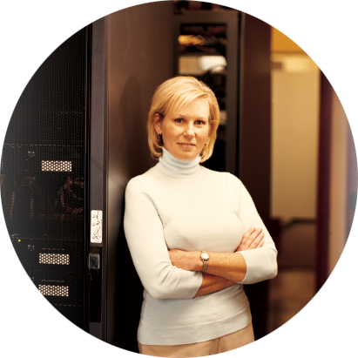

How you can help
Become a Technology Ambassador
Local female Technology role models for schools
Networking and information exchange opportunities for science teachers and related staff
Working with regional employers
Notes:
9/9/2008 3:30 PM
© 2005 Microsoft Corporation. All rights reserved.
This presentation is for informational purposes only. Microsoft makes no warranties, express or implied, in this summary.
25

Slide 26

http://imaginecup.com/
Notes:
Imagine Cup is the worlds largest student technology competition open to anyone in full time education aged over 16.
This year the theme is the UN millennium development goals (entries will address at least one):
End Poverty
and Hunger Universal Education Gender
Equality Child
Health Maternal
Health Combat
HIV/AIDS Environmental Sustainability Global Partnership
(http://www.un.org/millenniumgoals/)
Great opportunity to get something great on your CV whilst improving your skills and having a great time.
Hosted in Egypt this year there are 9 competitions...

Slide 27









Software Design
Embedded Development
Game Development
Short Film
IT Challenge
Design
Mashup
Photography
Robotics & Algorithm
Notes:
Software Design
We are asking students to create real world software and services applications that use Microsoft tools and technology. It's not just about the PC anymore - students need to think about taking advantage of mobile devices as well. Think big! The judging requires students to use their creativity and drive if they want to compete on the world stage. This is where legends are born and lives are changed - where an application starts as an idea and ends up being used all over the world.
Embedded Development
The object of the Embedded Development Invitational is to unleash students' creativity in an effort to change the world into a better place. They will develop their own embedded device whose function it is to better us all. The Embedded Development Invitational challenges students to go beyond the PC desktop and work in both hardware and software to build an embedded solution using Windows Embedded CE 6.0 R2 and the provided embedded platform.
Game Development
The object of the Game Development Invitational is to create a new game that uses both Microsoft's XNA Game Studio 3.0 and Visual Studio. Competitors' games should illustrate the Imagine Cup theme "Imagine a world where technology helps solve the toughest problems facing us today." This is a chance for students who've always enjoyed playing games to create their own game and at the same time help change the global community. The Game Development Invitational is a great opportunity for learning and advancement towards an important step in their budding careers either as a game developer or as an entrepreneur in the game business. This is the students' opportunity to build a full game from scratch!
Robotics and Algorithm
Robots need more than gears and wires - they require highly sophisticated algorithms to interpret and interact with the world around them. This competition is a mathematical obstacle course where students must navigate a series of brain teasers, code challenges and algorithmic puzzles to demonstrate their ability to understand the potential of robots in our world. This exciting event takes place in a virtual world as students progress through increasingly difficult rounds.
IT Challenge
Students are challenged to develop, deploy, and maintain IT systems that are elegant, functional, robust and secure. This demanding competition requires students to demonstrate their knowledge and skills in the science of networks, databases, and servers. They also need to show their analytical abilities and make tough decisions in IT environments.
MashUp
The object of the MashUp competition is to create a new and useful Web 2.0 application that is connected to the Imagine Cup theme "Imagine a world where technology helps solve the toughest problems facing us today." Students will use Microsoft PopFly to leverage current third party data and services available on the internet to create a new and unique tool that is effectively consumed by other internet users as their Imagine Cup entry.
Photography
Great photographers know a single image can change the world. In this competition, students communicate a story that explores a critical issue through a photo essay of inspiring still images. The photos must grab the audience and illustrate the students' personal insight into these global issues.
Short Film
We all love to go to the movies but some of us love to make movies! Filmmaking is a technical craft combined with the art of storytelling using moving images. A short film has the difficulty of conveying a message in a brief period of time while also being visually stimulating. In this competition, students will be challenged to create an original short film and also demonstrate excellence in filmmaking at all levels from concept art to polished editing.
Design
The object of the Design Invitational is to create a solution of an innovative design for easier machines and human interactions by inspiring students to use the power of technology as means to manifest their creativeness. The new, innovative design must bring a real benefit and address the challenges of the 2009 Imagine Cup Theme.
(http://imaginecup.com/Competition/Overview.aspx)

Slide 28
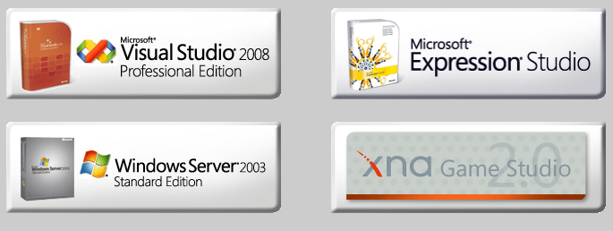
DreamSpark
http://downloads.channel8.msdn.com/
Notes:
Open to all university students.
Verify using Athens or NUS extra/ISIC cards
Includes VS/Expression/Server 2003 + Everything you need for XNA including a free creators club membership.

Slide 29
Agenda
Girls and Gadgets: The Future
  Alison Brown
Girls get E.X.I.T.Ed by IT
  Helena Pugsley
Motivating Young Women in Game Development via the Pixels, Programming, Play and Pedagogy Project
  Scott Leutenegger
Turning Girls onto Technology: The role of Professional Societies
  Cornelia Boldyreff
Discussion: A Vision for Science and Society: Influencing the government’s new consultation paper
  Ruth Wilson

Slide 30

© 2005 Microsoft Corporation. All rights reserved.
This presentation is for informational purposes only. Microsoft makes no warranties, express or implied, in this summary.

